Slide 1

FALL 2023
MIS 381N
Information management
Lecture 20
Oct 25th 2023
Prashant D. Joshi
UT McCombs School of Business (MSBA), The University of Texas at Austin

Slide 2

Objectives
Introduction to Spark
Progress on Final Projects
Quick recap of Hadoop/MapReduce
Motivation for Spark
Spark Overview
Questions and discussion

Slide 3
What questions may I answer before we begin …
All questions are good questions

Slide 4
Housekeeping
Project Status Update from each group representative
Spark-Intro pdf uploaded into Reading
Status of Hadoop/MapReduce homework?
Kubernetes homework not yet on Canvas… Will add it in after above homework deadline
Last homework on Snowflake will be after this
Last time’s class participation is only half-way entered… so don’t panic! ☺

Slide 5
SQL → MapReduce → …

Slide 6
Understanding the progression of tools …
Data Interaction
Data Management
Data Model
Compute/ Storage Infrastructure

Slide 7
Understanding the progression of tools …
 | Structured Data
Data Interaction | Structured Query Language (SQL)
Data Management | Relational Database Management System (RDBMS)
Data Model | Entity-Relationship Tables, columns, rows
Compute/ Storage Infrastructure | Centralized, Proprietary physical storage, Vertical scaling

Slide 8
Understanding the progression of tools …
 | Structured Data | Unstructured Data
Data Interaction | Structured Query Language (SQL) | Python, Java, …
Data Management | Relational Database Management System (RDBMS) | E.g. MapReduce Framework or Stack
Data Model | Entity-Relationship Tables, columns, rows | Key-value pairs, documents, graphs, …
Compute/ Storage Infrastructure | Centralized, Proprietary physical storage, Vertical scaling | Distributed, File based non-proprietary storage, horizontal scaling

Slide 9
Understanding the progression of tools …
 | Structured Data | Unstructured Data
Data Interaction | Structured Query Language (SQL) | Pig, Hive, Python, Java, … | In the real-world, data is structured and unstructured. Should we use disparate tools or should tools be integrated? Should the compute/ storage structure be integrated?
Data Management | Relational Database Management System (RDBMS) | MapReduce Framework of Stack
Data Model | Entity-Relationship Tables, columns, rows | Key-value pairs, documents, graphs, …
Compute/ Storage Infrastructure | Centralized, Proprietary physical storage, Vertical scaling | Distributed, File based non-proprietary storage, horizontal scaling

Slide 10
Hadoop … and Spark
Hadoop and Spark are the two most popular platforms for Big Data processing
They both enable you to deal with huge collections of data no matter its format — from Excel tables to user feedback on websites to images and video files
But which one of these is the right choice for your work?
You have looked at the general Hadoop architecture. Let’s do a quick review and see how this meta morphs into Spark

Slide 11
Hadoop and Spark general comparison
 | Hadoop | Spark
What is it? | Open-source framework for distributed data storage and processing | Open-source framework for in-memory distributed data processing and app development
Initial release | 2006 | 2014
Processing Methods | Batch processing, hard disks for read/write | Batch and micro-batch processing in RAM
Built-in Capabilities | File system (HDFS) Resource Management (YARN) Processing Engine (MapReduce) | Processing Engine (Spark Core) Near real-time processing (Spark Streaming) Structured data processing (Spark SQL) Graph data management (GraphX) ML Library (Mllib)
Supported Languages | Java | Scala, Java, Python, R
Optimal for | Delay-tolerant processing of huge databases | Almost instant processing of live data and quick analytics
Use Cases | Enterprise archived data processing Predictive maintenance Log file analysis | Fraud detection Telematics analysis User behaviour analysis Near real-time recommender systems Stock market trend prediction Risk Management
Source for many points https://www.altexsoft.com/blog/hadoop-vs-spark/

Slide 12
Hadoop quick recap
Apache Hadoop: Java based open-source framework for distributed storage and processing of huge datasets (since too large for a single computer)
The framework divides a huge data collection into smaller chunks across interconnected computers or nodes that make up a Hadoop cluster
As a result, a ‘Big Data Analytics’ task is split up, into parallel machines, transparent to the user
Advantages
Scalability (quickly add more machines to the cluster, virtually no limit on storage)
Versatility (leverage data from multiple sources and formats)
Cost effective and cheap to maintain
Reliability

Slide 13
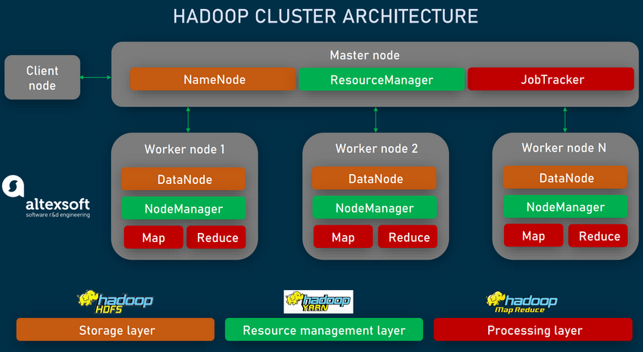
Hadoop quick recap
Apache Hadoop: Master, Slave, Client (or Edge for IO)
Master Nodes: Control and Coordinate the data storage and parallel processing
Slave nodes: Store and run computations according to M
Client: Interface with outside world
Storage Layer: Hadoop File System (HDFS)
Resource Management Layer: YARN (Yet another resource negotiator)
Resource Management Layer: YARN (Yet another resource negotiator)

Slide 14
Hadoop quick recap
HDFS (Hadoop Distributed File System)
Split blocks across computers
Typically write once read multiple times efficiency
Data replicated for resiliency
NameNode (metadata) and DataNodes (racks of 40-50 nodes connected to 1 network node)
YARN resource management software layer
monitors the usage of CPU, memory, and disk space
allocates resources to running applications
schedules jobs based on the application requirements
Processing Layer (MapReduce)
Two phases, first of map, and second of reduce

Slide 15
MapReduce Issues
All data processing tasks need to be decomposed into Map and Reduce steps
“Acyclic Data Flow” from Disk to Disk (HDFS)
Read and write to disk before and after Map and Reduce, making it inefficient for iterative tasks such as the ones required for Machine Learning algorithms
Efficient for streaming data, but less efficient for interactivity and batch processing

Slide 16
Hadoop limitations
Hadoop alone has many limitations
Small file problem: Hadoop was created to deal with huge datasets. For every data unit, the NameNode stores metadata with names, access rights, locations, etc. Millions of small files will evidently occupy too much memory in the Master Nodes and slow down the processing
High data access latency: high throughput in large data batches, but the expense of latency
Real-time Data Access: Unsuitable for nearly real-time data access
Complex programming environment: Java and Java APIs knowledge

Slide 17
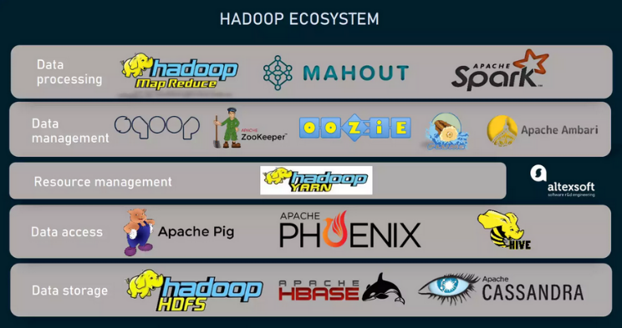
Apache Hadoop Ecosystem
These pitfalls along with the need to cover an end-to-end Big Data workflow prompted the emergence of various compatible additional services, together, Hadoop ecosystem — a suite of tools supplementing the framework and addressing its limitations.
Apache Spark, the big star of the Big Data world was born from the need to process data much faster than MapReduce.
Sqoop for data transfer between RDBMs and Hadoop; Oozie for scheduling jobs; Flume for help on log data analysis
Apache PHOENIX, Pig etc help with SQL queries into HBASE commands
Hbase: NoSQL db on top of HDFS. “In-Memory” processing enables quick real time access

Slide 18
SQL → MapReduce → Spark

Slide 19
Apache Spark
Apache Spark supports data analysis, machine learning, graphs, streaming data, etc. It can read/write from a range of data types and allows development in multiple languages.
Scala, Java, Python, R, SQL
DataFrames
ML Pipelines
Spark SQL
Spark Streaming
MLlib
GraphX
Spark Core/RDDs
Data Sources
Hadoop HDFS, HBase, Hive, Apache S3, Streaming, JSON, MySQL, and HPC-style (GlusterFS, Lustre)

Slide 20
Spark facts
A general framework for distributed computing leveraging the Hadoop ecosystem, designed specifically to replace MapReduce
In-memory caching of data for efficient iterative, graph, and other types of tasks needed to support machine learning algorithms
Supports interactive data analysis required for exploratory data analysis
Lazy Evaluation
The main difference between Hadoop and Spark lies in data processing methods
MapReduce stores intermediate results on local discs and reads them later for further calculations. In contrast, Spark caches data in the RAM (Random Access Memory) which is orders of magnitude faster!

Slide 21

Example of Lazy Evaluation
Get a list of numbers
Square each of them
Obtain the list of even numbers
Find the average of all the above even numbers <<< This is where execution starts
# Create an RDD with a list of numbers
numbers = sc.parallelize([1, 2, 3, 4, 5, 6, 7, 8, 9, 10])
# Transformation 1: Square each number
squared_numbers = numbers.map(lambda x: x ** 2)
# Transformation 2: Filter out even numbers
even_numbers = squared_numbers.filter(lambda x: x % 2 == 0)
# Transformation 3: Find the sum of squared numbers
sum_of_squares = squared_numbers.reduce(lambda x, y: x + y)
# Action: Print the result
print("Sum of the squares of even numbers:", sum_of_squares)
Question: Do we need to square the odd numbers at all?
Spark Lazy Evaluation
- Optimization: merge, reorder, eliminate unnecessary transformations
- Efficiency: transformations are evaluated ONLY when action is invoked

Slide 22
Another feature: Persistence
Recall that RDDs are recomputed as needed
– An action initiates evaluation
– Additional action results in another evaluation
An RDD can be persisted for efficiency
Making an RDD persistent:
– cache()
– persist(StorageLevel level)
Why do you think you might need this?
Example: Persistence is particularly valuable for iterative algorithms, such as machine learning algorithms like gradient descent or graph algorithms like PageRank. Without persistence, these algorithms would recompute the same data in each iteration, resulting in significant performance overhead

Slide 23
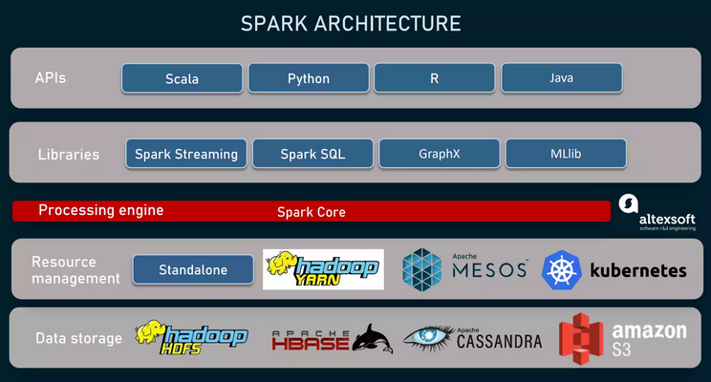
Spark facts
Spark Stack
The framework is the computational engine known as Spark Core
Distributed data processing
Memory Management
Task Scheduling
Fault recovery
External IO
Spark Libs (Spark SQL, ML libs, Spark R)

Slide 24
Spark facts
Designed specifically to replace MapReduce
Uses local RAMs for data transfer resulting in orders of magnitude speedup
The fundamental data structure Spark Core works with is Resilient Distributed Dataset (RDD)
Basically, it’s a read-only and fault-tolerant collection of records that can be processed in parallel, hiding partitioning from an end-user.
RDD easily handles both structured and unstructured data
DataFrames are used to organize information in the named columns, like tables in relational databases

Slide 25
Spark vs MapReduce
A key distinction between Spark and MapReduce is that Spark provides a broader set of high-level APIs and libraries that go beyond the “Map” and “Reduce” operations!
JOINS (inner, outer, etc. between different datasets)
Filtering (similar to SQL’s WHERE)
Grouping and Aggregation (ex. SUM, COUNT, AVG, MIN, MAX, etc)
Sorting (asc, desc, across multiple columns)
Spark SQL allows SQL-like queries on structured data
ML libraries for machine learning algorithms, data analysis, predictive modelling etc
Graph Processing (GraphX lib enable graph processing ops)
Real Time Streaming (well… sort of!)

Slide 26
Spark has no default storage system and resource manager
Unlike Hadoop, which unites storing, processing, and resource management capabilities, Spark is for processing only, having no native storage system.
Instead, it reads/writes data from/to different sources, including HDFS, HBase, and Apache Cassandra, etc. It is compatible with data repositories, outside the Hadoop ecosystem such as Amazon S3.
Processing data across multiple servers, Spark cannot control resources (CPU and memoy) by itself
Hence it needs a resource or cluster manager.
Currently, the framework supports four options:
Standalone, a simple pre-built cluster manager
Hadoop YARN, which is the most common choice for Spark
Apache Mesos, used to control resources of entire data centers and heavy-duty services
Kubernetes, a container orchestration platform
(Running Spark on Kubernetes makes sense if a company plans to move the entire company tech stack to the cloud-native infrastructure)

Slide 27
Native libraries: Spark Streaming, Spark SQL, MLlib, and GraphX
While using an external cluster manager and data repository, Spark comes with a stack of four libraries that allow for creating various analytics apps on top of a single platform.
Spark Streaming empowers the core engine with near-real-time processing capabilities and facilitates building streaming analytics products. The module can absorb live data streams
Spark SQL creates a communication layer between RDDs and relational databases. It allows data scientists to conveniently query structured data in Spark programs.
GraphX offers a set of operators and algorithms to run analytics on graph data.
MLlib is a scalable machine learning library, containing algorithms for a range of ML tasks such as classification, clustering, and regression. It also provides tools for statistics, creating ML pipelines, model evaluation, and more
Multi-language intuitive APIs
Spark core engine, data structures, and libraries are available via developer-friendly APIs. Written in Scala, the framework also supports Java, Python, and R, enabling experts with other languages (compared to Java-centric Hadoop)

Slide 28
Spark Limitations
Spark has some advantages over Hadoop’s MapReduce engine. Yet, it also comes with certain drawbacks
Pricey hardware. RAM prices are higher than those of hard discs exploited by MapReduce, making Spark operations more expensive.
Near, but not truly real-time processing. Spark Streaming and in-memory caching allow you to analyze data very quickly. But still it won’t be truly real-time, since the module works with micro-batches — or small groups of events collected over a predefined interval. Genuine real-time processing tools process data streams at the moment they are generated.
Hence not a perfect fit for IOT issues, where Apache Flink might help with live data processing
Issues with small files. Like Hadoop, Spark doesn’t cope well with a large number of small datasets. More files within a workload mean more metadata to parse and more tasks to schedule, which can slow up the processing dramatically.

Slide 29
… so, how do we choose between Hadoop and Spark?
Strictly speaking, the choice is not between Spark and Hadoop, but between two processing engines, since Hadoop is more than that.
A clear advantage of MapReduce is that you can perform large, delay-tolerant processing tasks at a relatively low cost. It works best for archived data that can be analyzed later — say, during night hours.
Some real-life use cases are
online sentiment analysis to understand how people feel about your products
predictive maintenance to address issues with equipment before they really happen
log files analysis to prevent security breaches
Spark in turn, shines when speed is prioritized over price. It’s a natural choice for
fraud detection and prevention,
stock market trends prediction,
near real-time recommendation systems
risk management
Yet, other factors — like availability of experts — may also tip the scale. Besides that, the efficiency of Spark and Hadoop depends greatly on the right tools they are combined with.

Slide 30

Next class
Topic Focus: Spark, MongoDB

Slide 31
What questions may I answer before we conclude …
All questions are good questions

Slide 32
Appendix

Slide 33
Apache Big Data Ecosystem (partial)
Data Interaction
Data Management
Compute/ Storage Infrastructure
Pig, Hive, Impala
Computing Framework (MapReduce, Spark, Storm)
NoSQL Database (Hbase)
Distributed Resource Management (YARN, Mesos ZooKeeper, Oozie)
Hadoop Distributed File System (HDFS)

Slide 34
Disk vs. In-memory
MapReduce: Use Disk for Data Sharing
HDFS
read
HDFS
Write
HDFS
read
HDFS
Write
Iteration1
Iteration2
Spark: In-Memory Data Sharing
HDFS read
Iteration1
In- memory
Iteration2
In- memory

Slide 35
Sort performance comparison
 | Hadoop MR Record (2013) | Spark Record (2014)
Data Size | 102.5 TB | 100 TB
Elapsed Time | 72 mins | 23 mins
# Nodes | 2100 | 206
# Cores | 50400 physical | 6592 virtualized
Cluster disk throughput | 3150 GB/s (est.) | 618 GB/s
Network | dedicated data center, 10Gbps | virtualized (EC2) 10Gbps network
Sort rate | 1.42 TB/min | 4.27 TB/min
Sort rate/node | 0.67 GB/min | 20.7 GB/min
Spark is 3x faster with 1/10 the nodes
Sort benchmark, Daytona Gray: sort of 100 TB of data (1 trillion records)
http://databricks.com/blog/2014/11/05/spark-officially-sets-a-new-record-in-large-scale-sorting.html

Slide 36
Production applications of Spark
Uber gathers terabytes of event data from its mobile users every day
Continuous ETL pipeline using Kafka, Spark Streaming, and HDFS
Raw unstructured event data converted to structured data in real-time
These data are used for complex analytics and operations optimization
Pinterest – Uses a Spark ETL pipeline
Leverages Spark Streaming to gain immediate insight into how users all over the world are engaging with Pins—in real time.
Can make more relevant recommendations as people navigate the site
Recommends related Pins
Determine which products to buy, or destinations to visit

Slide 37
Production applications of Spark
Conviva, streaming video company second only to YouTube with 4 million video feeds per month
Uses Spark to reduce customer churn by optimizing video streams and managing live video traffic
Maintains a consistently smooth, high quality viewing experience
Capital One
Uses Spark and data science algorithms to understand customer behavior, develop new financial products and services and find attributes and patterns that point to an increased probability for fraud
Netflix
Leverages Spark to understand viewing habits, recommends content and drive new content creation

Slide 38
Spark High Level Structure
Structured Streaming
Advanced Analytics
Ecosystem
Spark Core
Structured APIs
Datasets DataFrames SQL
Low Level APIs
Distributed Variables RDDs

Slide 39
Spark Components

Slide 40
Spark API Language Support
Scala, Java, Python, R, SQL

Slide 41
Spark Storage Support
Scala, Java, Python, R, SQL
HDFS, S3, Azure, Kafka, …

Slide 42
Spark Architecture
Driver Process
Executors
Spark Session
User Code
Cluster Manager

Slide 43
Data Representation in Spark
Resilient Distributed Datasets (RDDs)
Fundamental data structure of Spark
Read-only partition collection of records.
A programmer can perform in-memory computations on large clusters in a fault-tolerant manner
Efficient and performant
DataFrame API
Data organized into named columns
Immutable distributed collection of data.
A programmer can impose structure onto a distributed collection of data, allowing higher-level abstraction
Dataset:
Extension of DataFrame API
Type-safe, object-oriented programming interface

Slide 44
Resilient Distributed Datasets (RDDs)
RDDs (Resilient Distributed Datasets) play the role of data containers
All the different processing components in Spark share the same abstraction called RDD
As applications share the RDD abstraction, you can mix different kind of transformations to create new RDDs
Created by parallelizing a collection or reading a file
Fault tolerant

Slide 45
DataFrames
DataFrames (DFs) are distributed datasets organized in named columns
They are similar to tables in a relational database, Python Pandas Dataframe or DataTables in R
Immutable once constructed
Track lineage
Enable distributed computations
How to construct DataFrames?
Read from file(s)
Transform an existing DF(Spark or Pandas)
Parallelizing a python collection list
Apply transformations and actions

Slide 46
DataFrame examples
// Create a new DataFrame that contains “students”
students = users.filter(users.age < 21)
//Alternatively, using Pandas-like syntax
students = users[users.age < 21]
//Count the number of students users by gender
students.groupBy("gender").count()
// Join young students with another DataFrame called logs
students.join(logs, logs.userId == users.userId,
“left_outer")

Slide 47
Spark Operations
Transformations (create a new RDD) | map filter sample groupByKey reduceByKey sortByKey intersection | flatMap union join cogroup cross mapValues reduceByKey
Actions (return results to driver program) | collect first Reduce take Count takeOrdered takeSample countByKey take save lookupKey foreach

Slide 48
Narrow vs. Wide transformations
Narrow transformations do not require shuffling of data across a partition – group into single stage
Wide transformations cause data shuffles – results in stage boundaries.
Each RDD maintains a pointer to one or more parents along with metadata about what type of relationship it has with the parent.
if we call val b=a.map() on an RDD, the RDD b keeps a reference to its parent RDD a, that’s an RDD lineage.
Narrow
Vs.
Wide
A,1
A,[1,2]
A,2
Map/Reduce
groupByKey

